Slide 1
Haleh Byrne—Product Lead for IES Industrial Engineering Solutions
haleh_byrne@ncsu.edu www.ies.ncsu.edu

Slide 2

“If you’re not keeping score, you are just practicing.”
—Vince Lombardi

Slide 3
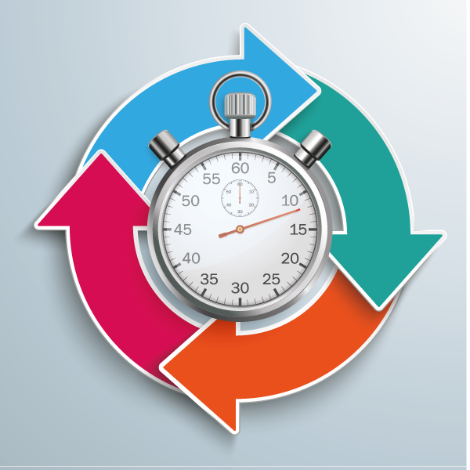
What is Work Measurement?
Work Measurement is the determination of the length of time it should take to complete a job.
Systematic determination of the amount of effective physical and mental work in terms of work units in a specified task.

Slide 4
Time Standards. When to Use?
Product costing
Delivery
Capacity analysis
Equipment purchase justification
Efficiency improvement: scope and requirement
System simulation
Labor requirements
Determination of wage payment plans
Labor law compliance
System simulation
Lean Six Sigma application

Slide 5
Lack of Correct Standard Times? Implications?
Unpredictable time
Unpredictable results
Inefficient allocation of resources
Inaccurate operation cost estimates

Slide 6
The Whole Picture
Improved production planning and scheduling
Focus on Time assessment and management
Work Measurement
Lean Six Sigma application
Increased capability to adapt customer demand
Excess inventory reduction
Manufacturing costs
reduction

Slide 7
PDSA Approach to Work Measurement

Slide 8
Keys to Success
Involve employees
Prepare and motivate people
Have information and manage expectations
Work Measurement program success

Slide 9
Work Measurement Benefits
Common currency for the evaluation and comparison of all types of work
Methods improvement
Performance standard provision
Allows for additional compensation for better performance
Cost reduction by focusing on productivity improvement and elimination of waste in the process

